Slide 1
CASE STUDY
Motion picture Data Analysis using SQL
- Rohan Deshmukh

Slide 2
Sakila DataBase
This Motion Picture Data Analysis is performed on Sakila DataBase.
Based on data different task analysis need to done to obtain the desired output.
As per the tables and data in Sakila Database few such Analysis were done

Slide 3
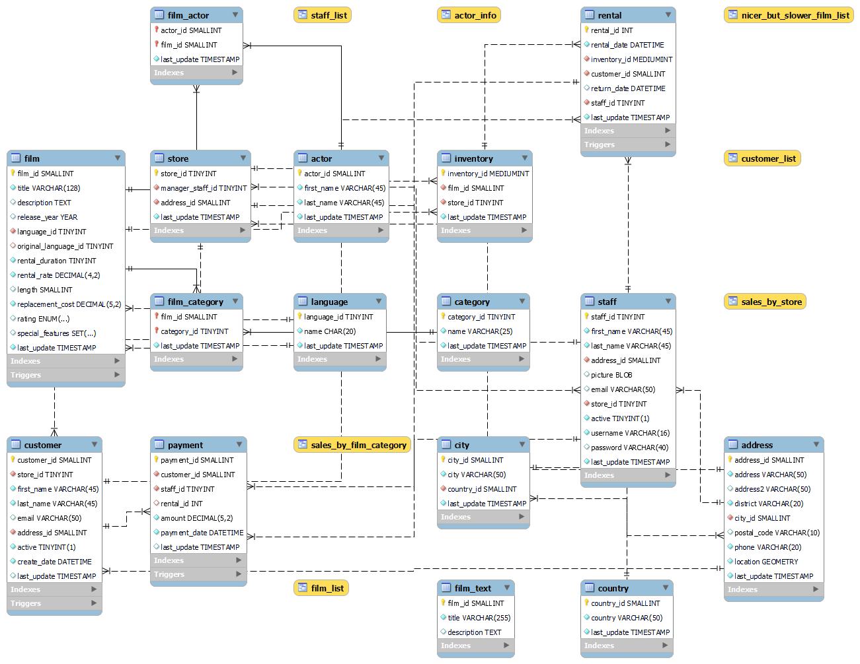
SAKILA DATABASE Er diagram

Slide 4

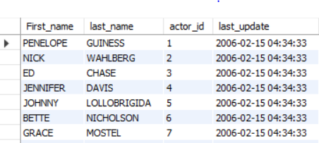
Task 1: The Sakila rental store management wants to know the names of all the actors in their movie collection. Display the first names, last names, actor IDs, and the details of the last_updated column.
Code:
Output :
Conclusion : Using Skila database we selected some Parameters to display the output from Actor table such as actor names ,id and last update.

Slide 5

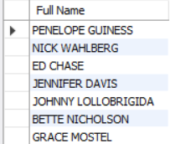
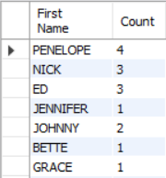
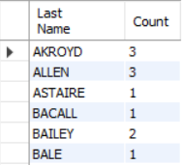
Task 2: Many actors have adopted attractive screen names, mostly at the behest of producers and directors. The management wants to know the following: a. Display the full names of all actors. b. Display the first names of actors along with the count of repeated first names. c. Display the last name of actors along with the count of repeated last names
Code:
Task 2a
Task 2b
Task 2c
Output :
Conclusion : In this we using Concat, Count and Group By function to get full name and count of name repeated in Actor table

Slide 6
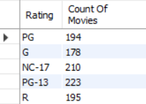
Task 3: Display the count of movies grouped by the ratings
Code:
Output :
Conclusion : We are using Count and Group by function to get number of movies based on Rating from Film table

Slide 7
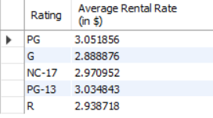
Task 4: Calculate and display the average rental rates based on the movie ratings.
Code:
Output :
Conclusion : We are using Average and Group by function to get number of movies based on Rating from Film table

Slide 8
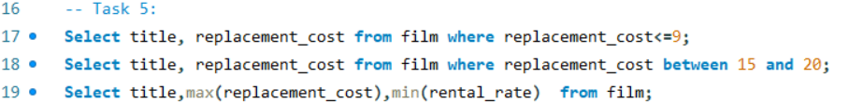

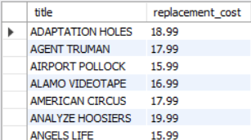

Task 5: The management wants the data about replacement cost of movies. Replacement cost is the amount of money required to replace an existing asset (DVD/blue ray disc) with an equally valued or similar asset at the current market price. a. Display the movie titles where the replacement cost is up to $9. b. Display the movie titles where the replacement cost is between $15 and $20. C. Display the movie titles with the highest replacement cost and the lowest rental cost.
Code:
Task 5a
Task 5b
Task 5c
Output :
Conclusion : We are using Comparison operator, Min ,Max and Between on replacement cost and rental rate to get desired output from film table

Slide 9
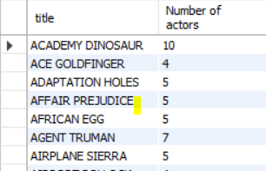
Task 6: The management needs to know the list all the movies along with the number of actors listed for each movie.
Code:
Output :
Conclusion : We are using join to connect 2 tables film and film_actor using filmid from both table to get movie name and number of actor in the movie

Slide 10
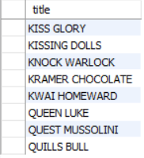
Task 7: The Music of Queen and Kris Kristofferson has seen an unlikely resurgence. As an unintended consequence, movies starting with the letters 'K' and `Q` have also soared in popularity. Display the movie titles starting with the letters 'K' and `Q`.
Code:
Output :
Conclusion : We are using like function to get title starting from letter K and Q

Slide 11
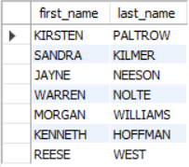
Task 8: The movie 'AGENT TRUMAN' has been a great success. Display the first names and last names of all actors who are a part of this movie.
Code:
Output :
Conclusion : We are using join to connect 3 tables film, actor and film_actor using film_id and actor_id from respective table to get actors names from specific movie

Slide 12
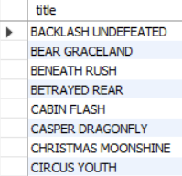
Task 9: Sales has been down among the family audience with kids. The management wants to promote the movies that fall under the 'children' category. Identify and display the names of the movies in the family category
Code:
Output :
Conclusion : We are using join to connect 3 tables film, film_category and category using film_id and category_id from respective table to get name of movie which are in Children and family (I’m using children genre because it ca also consider in family genre)

Slide 13
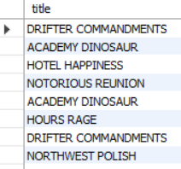
Task 10: Display the names of the most frequently rented movies in descending order, so that the management can maintain more copies of such movies.
Code:
Output :
Conclusion : We are using join to connect 3 tables film, inventory and rental using film_id and inventory_id from respective table to get name of movie in descending order based on count of inventory

Slide 14
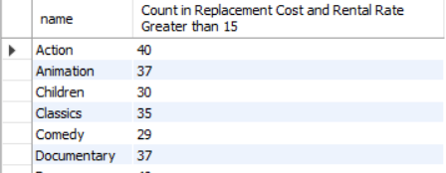
Task 11: Calculate and display the number of movie categories where the average difference between the movie replacement cost and the rental rate is greater than $15.
Code:
Output :
Conclusion : We are using join to connect 3 tables film, film_category and category using film_id and category_id from respective table to get genres and count of movies whose rental rate is greater than 15 we used comparison for finding greater than value

Slide 15
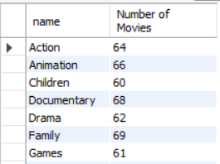
Task 12: The management wants to identify all the genres that consist of 60-70 movies. The genre details are captured in the category column. Display the names of these categories/genres and the number of movies per category/genre, sorted by the number of movies..
Code:
Output :
Conclusion : We are using join to connect 2 tables film and film_category using category_id from table to get genres and count of movies who have 60 to 70 movies

Slide 16
Summary
IN TASK WE HAVE PERFORMED ALOT OF OPERATION ON SAKILA DATABASE TO GET TO UNDERSTAND SEVERAL FUCTIONALITIES OF SQL AND GET DESIRED OUTPUTS
WE GET TO KNOW HOW TO DISPLAY SPECIFIC DATA WITH THE HELP OF COMPARION OPERATOR, HOW TO USE JOIN, GROUP BY, ORDER BY, COUNT, HAVING, AVERAGE, BETWEEN, SORTING, MIN, MAX ,ETC

Slide 17
Thank you

